Slide 1

ONLINE LOAN MANAGEMENT SYSTEM An Avalon’s team project
SUBMITTED TO
Dr. Reza Sadeghi

Slide 2
Outline
Team Members
Introduction
Description
Application flow
Software Requirements
Entity Relationship Model
Enhanced Entity-Relationship Model
SQL Database Development
Loading Data & Performance Enhancement
Graphical User Interface
References

Slide 3
Team Members
Samba Chennamsetty – Team Head
Arif Pasha Shaik – Team Member
Jagadishwar Reddy Velma – Team Member
Siva Rama Krishna Ch – Team Member
Teja Sri Ravula – Team Member
Vamsi Kiran Kakkera - Team Member

Slide 4
Introduction
Online loan Management System (OLMS) is a project which is taken and being developed by our team which helps loan applicants’ apply for loans online.
Applicants have to fill online loan application form to apply for a loan.
Branch employee has the authority to approve or reject loan applications.
Customer can view their Loan account details, Interest rate, repayment schedule details, etc. from the web application.
The business model we choose for the project are Happy Money Loan Provider [1], PenFed Credit Union [2], and Light Stream Loans [3].
This system is designed to easily maintain the data of the loan customers specifically. Customers can apply for loans without visiting the bank.

Slide 5
DESCRIPTION
Application consists of multiple modules that communicate with customers and branch employees.
Customer Account module
Loan Application Module
Loan account Module
Loan Payment Module
Employee Dashboard Module
Settings Module
Activity Module

Slide 6
APPLICATION FLOW
User Interface
Web application UI that communicates with backend programming language.
Backend Server
Database server
MySQL database that communicates with backend developed in java to process data.
Backend development in java to communicates with database and user interface

Slide 7
Software requirements
Backend: Java 8, Spring Boot Framework 2.4
User Interface: HTML, CSS, Bootstrap, JavaScript, Ajax & jQuery
Database: MySQL, Workbench
Server: Apache Tomcat 8.5
Browser: Google Chrome

Slide 8
Entity relationship model
Entity relationship model designed with 10 database tables, which have relationships with other tables.
Tables:
Branch
Customer
EMI
Employee
Loan Information
Loan Offers
Loan Request
Loan Type
Payment Info
User Activity

Slide 9
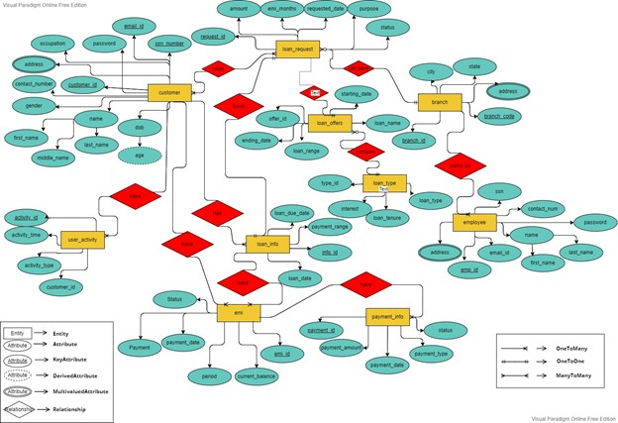
Entity relationship model

Slide 10
Enhanced Entity-Relationship Model
Enhanced Entity-Relationship model describes the table structure with column-level datatypes.
Each rectangle box denotes a table of the schema and inside of it describes attributes of the table.
The dotted lines describe a table that has a relationship with another table.
Each such established relation has a constraint that connects one with another.
The table structure, data types of columns, and relations between them will be generated using reverse engineering from the workbench software.

Slide 11
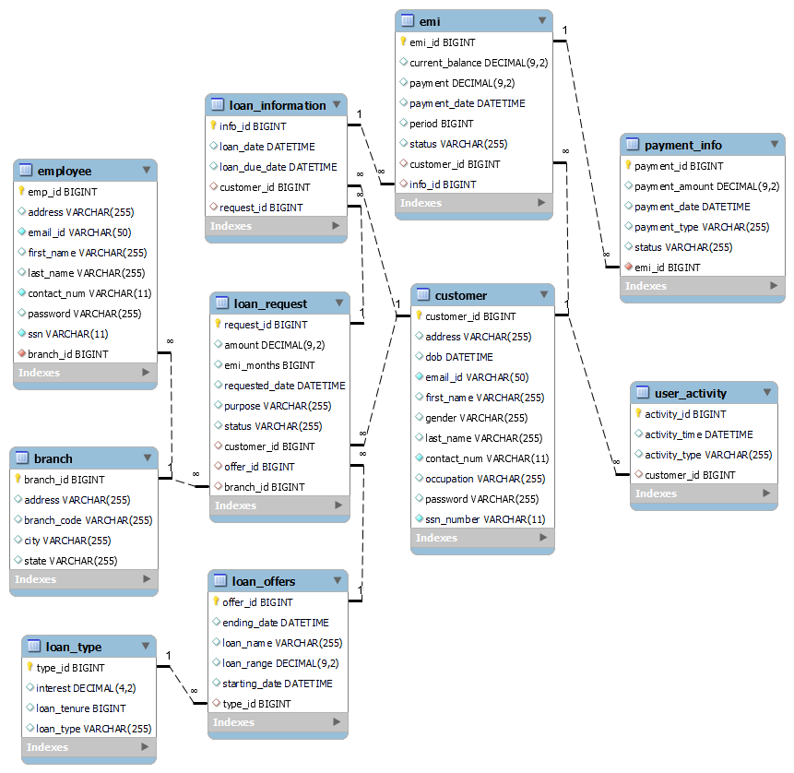
Enhanced Entity-Relationship Model

Slide 12
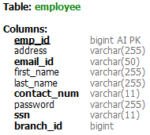
SQL Database Development
Employee table below created by using CREATE from MySQL workbench. For this DB developer has to specify each column name along with proper datatype.

Slide 13
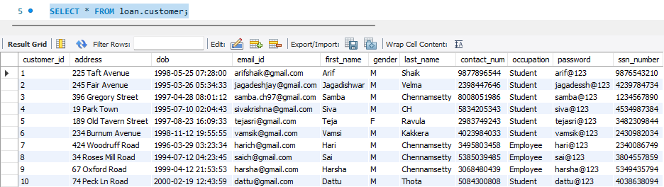
SQL Database Development
This is the customer table created and data inserted by using MySQL quires for application operations.
Here we used the SELECT operation is used to fetch all rows from the customer table.

Slide 14


SQL Database Development
Adding new column middle_name to employee table using ALTER command
Deleting existing column middle_name using ALTER command from employee table.
Deleting inserted record from the employee table based on emp_id using WHERE condition

Slide 15
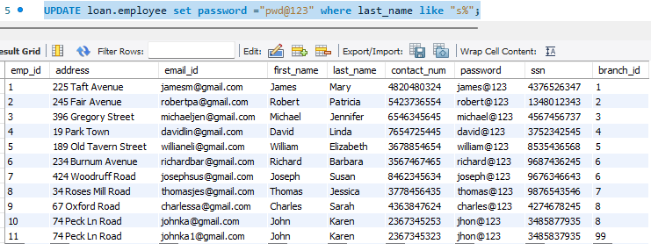
SQL Database Development
The UPDATE operation is used to update the multiple rows using the WHERE condition, with this matching records from where the condition will update to new values.

Slide 16

Loading Data & Performance Enhancement
By connecting the database with backend technology by giving valid credentials (URL, driver-class-name, username, and password) developer loads the data from the database server to the backend.
Backend technology has to process or modify data before sending it to the User Interface.
The below is the database connecting from the java spring framework to the MySQL database server of loan schema.

Slide 17
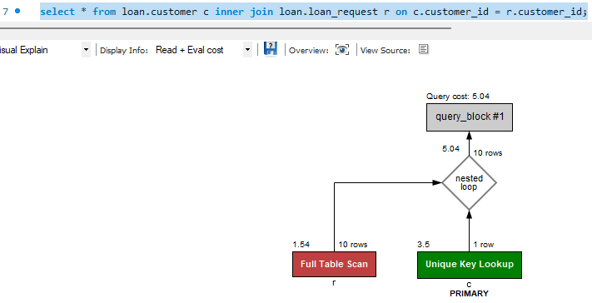
Loading Data & Performance Enhancement
By providing valid data to the database tables and proper foreign key values, the server is able to fetch the data as early as possible and that results in the performance of the query.

Slide 18
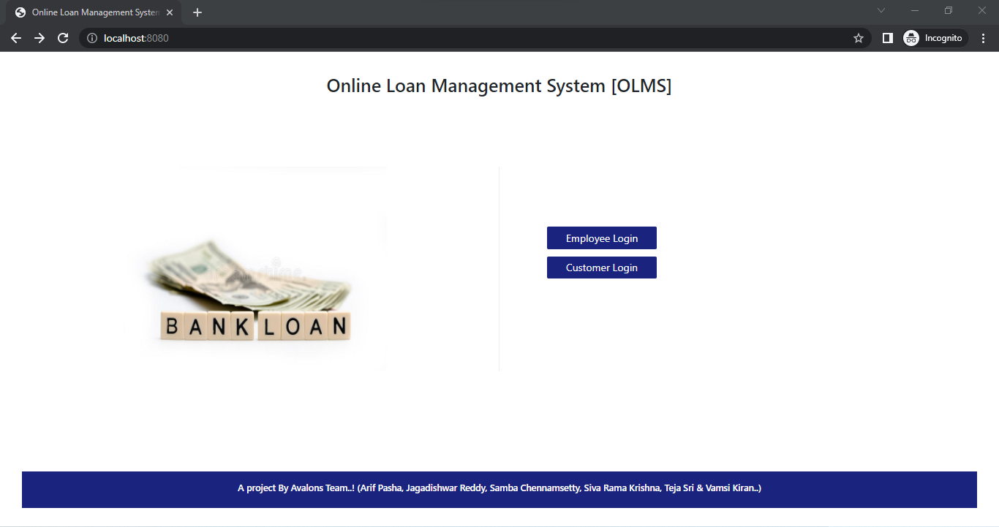
Graphical User Interface
Index page contains both the login pages of employee and customer. Successful customer login redirects to customer dashboard & employee as well.

Slide 19
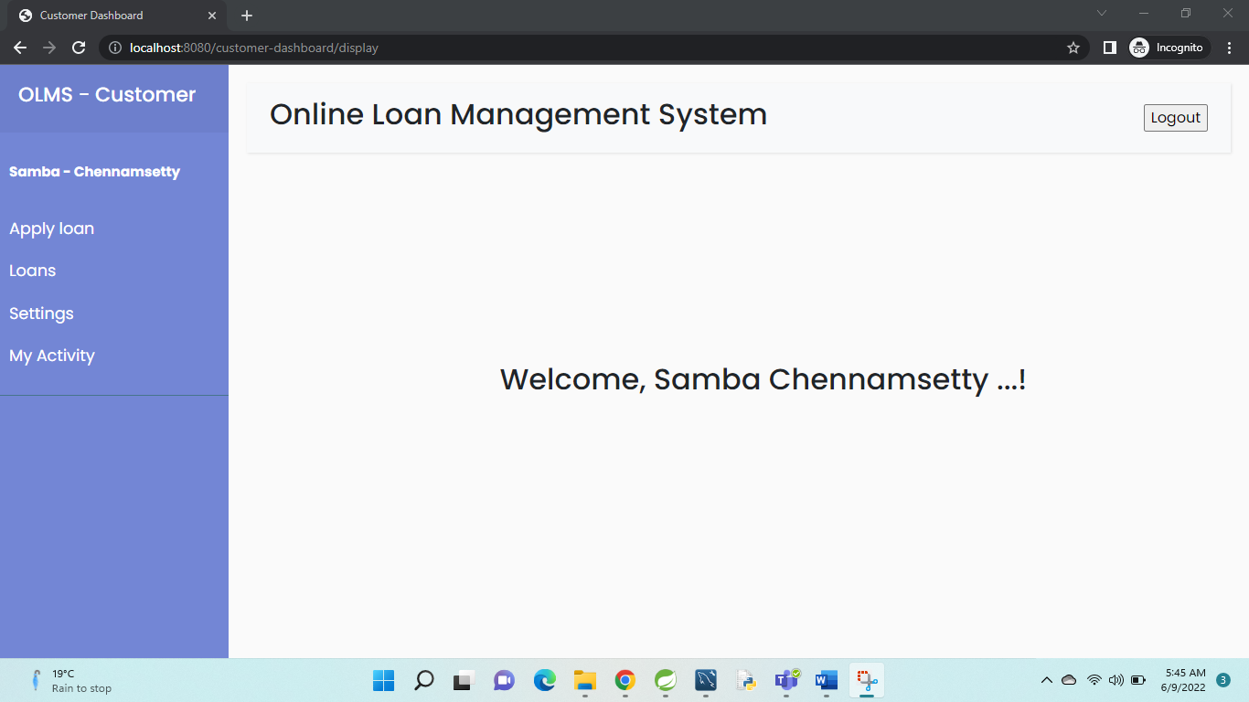
Graphical User Interface
Customer has to enter valid credentials to enter into their dashboard.

Slide 20
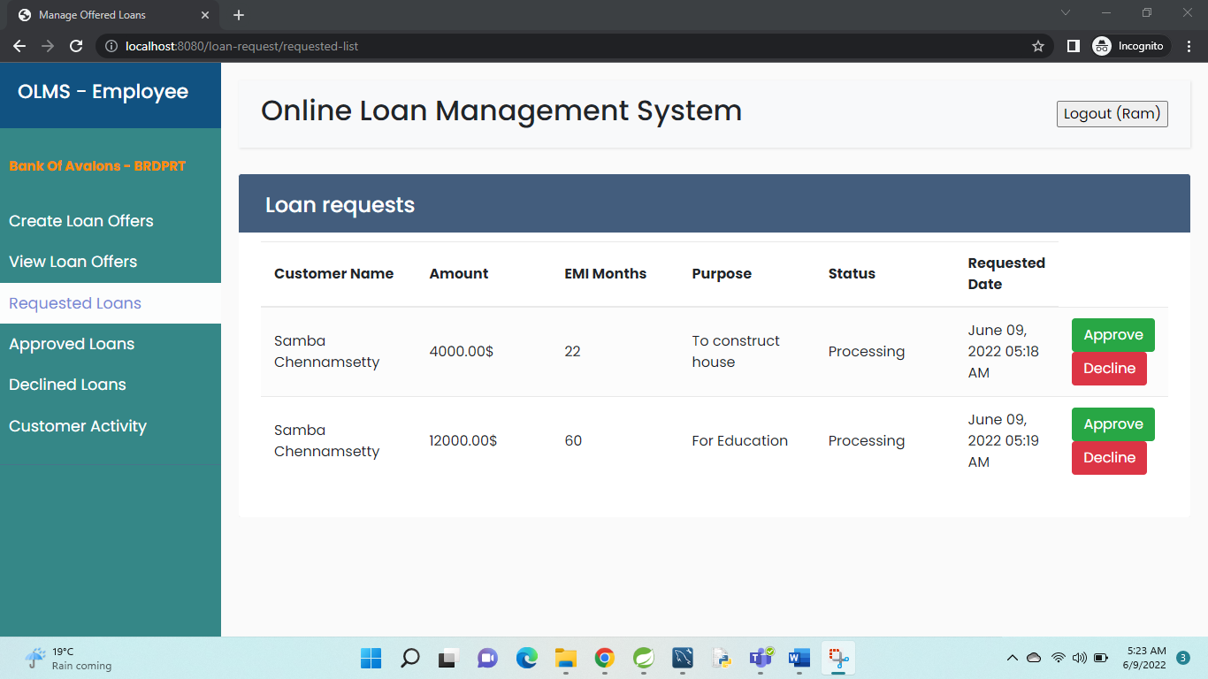
Graphical User Interface
Once the customer applied for the loan from his dashboard, the respective bank employee receives the request. Then the employee is able to see the requested loans from the navigation bar.

Slide 21
Graphical User Interface
The rest of the flow continues by running the application.
Application URL: http://localhost:8080

Slide 22
REFERENCES
[1] "About Happy Money Loan Company," [Online]. Available: https://happymoney.com/company
[2] "About PenFred Credit Union," [Online]. Available: https://www.penfed.org/personal/personal-loans
[3] "Theme Of Light Stream," [Online]. Available: https://www.lightstream.com/about-us

Slide 23
GITHUB REFERENCE
https://github.com/samba-chennamsetty/online-loan-management-system-avalons

Slide 24

Any questions ?

Slide 25
Thank you…!

